Slide 1
Models, designing schemas, seeding data, and migrations
WorkShop - 04
Team - Phoenix

Slide 2




Team Members:
Thallada, Prashanth Kumar Komerisetti, Sri Ram Teja, Thannir, Vyshnavi Srilaxmi Kantipudi, Chandra Mouli

Slide 3
Contents:
Models
Types of models
Designing Schema
ER Diagram
Data Seeding
Migration

Slide 4
Models
Model is responsible for the application’s state and non-UI specific behavior.
Model should contain all of our application business logic, validation logic, and database access logic.
In general a developer should strive for fat models with skinny controllers.
Prashanth Kumar Thallada

Slide 5
Types of models
Domain model
View model
Binding model
API model
Persistence model
Prashanth Kumar Thallada

Slide 6
Domain Model
Domain model is also often referred to as the entity model or simply as the data model.
Domain models can be implemented by creating POCO classes that will implement your domain entities.
POCO stands for plain old C# objects, It’s basically the .NET version of POJO.
POCO doesn’t have any persistence methods.
Prashanth Kumar Thallada

Slide 7
View Model
These can be found in MVVM (model-view-viewModel) programming architecture pattern.
The viewmodel sits between the model and view and serves as a buffer between them.
For instance, your viewmodel can provide a Submit command for a form that the view can implement as a button of a link.
Prashanth Kumar Thallada

Slide 8
Designing Schemas
A Schema is a pictorial representation of the relationship between the database tables in the database.
The database schema of a database system is its structure.
Described in a formal language supported by the database management system.
Sri Ram Teja
Notes:
A database schema is the skeleton structure that represents the logical view of the entire database. It defines how the data is organized and how the relations among them are associated. It formulates all the constraints that are to be applied on the data.

Slide 9
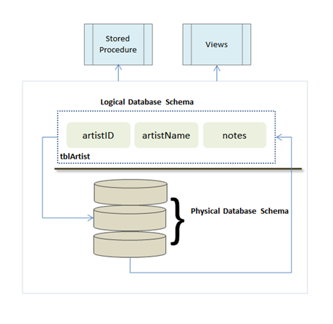
DataBase Schemas
A full database schema is actually a physical schema and a logical schema.
Think of a schema as a container of objects.
Figure 1
Sri Ram Teja
Notes:
Reference: https://study.com/academy/lesson/how-to-design-a-database-schema.html

Slide 10
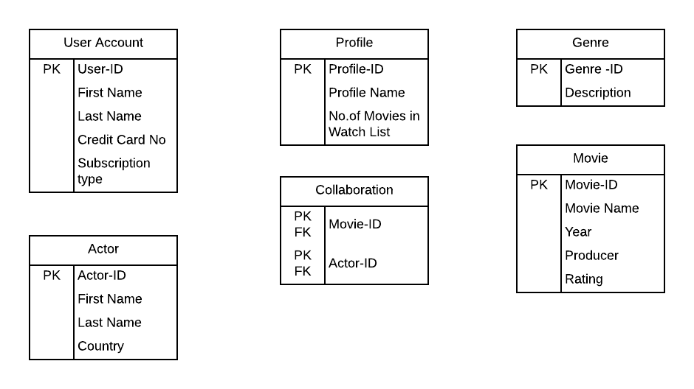
How to Design a Schema
Figure 2
Sri Ram Teja
Notes:
The above Figure 2 depicts the various tables which describes the pictorial representation of the data. All the above table is not yet related with each other.

Slide 11
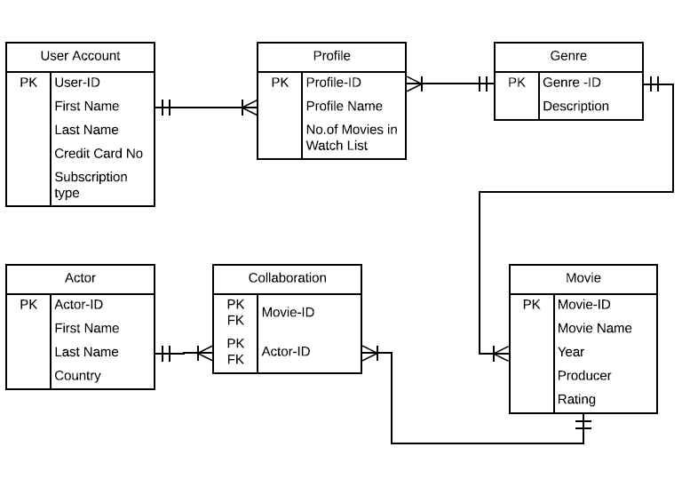
ER Diagram
Figure 3
Sri Ram Teja
Notes:
The above figure 3 represents all the data which are in relation with each other.

Slide 12
Data Seeding
Populating the data into database is called Data Seeding.
Check the target exists or not.
If it does, Comparison is done with the model stored in metadata in the database.
If it doesn’t, database is dropped.
If neither it’s created.
Once the Database is created, initializer Seed method is called.
Vyshnavi Srilaxmi Thannir
Notes:
Reference : https://docs.microsoft.com/en-us/ef/core/modeling/data-seeding

Slide 13
Different ways
Different ways in which data seeing can be done is using:
Model seed data.
Manual migration customization.
Custom initialization logic.
Vyshnavi Srilaxmi Thannir
Notes:
Reference : https://docs.microsoft.com/en-us/ef/core/modeling/data-seeding

Slide 14
Limitations
Seed data is managed by migrations and script to update the data.
The primary key value needs to be specified.
Previously seeded data will be removed if the primary key is changed in any way.
Vyshnavi Srilaxmi Thannir
Notes:
Reference : https://docs.microsoft.com/en-us/ef/core/modeling/data-seeding

Slide 15
Migrations
A data model changes during development and gets out of sync with the database.
You can drop the database and let EF create a new one that matches the model, but this procedure results in the loss of data.
Migrations provides a way to incrementally update the database schema.
It syncs with the application's data model while preserving existing data in the database.
Chandra Mouli Kantipudi
Notes:
Reference: https://docs.microsoft.com/en-us/ef/core/managing-schemas/migrations/

Slide 16
List of Tasks
Create a migration
Update the database
Customize migration code
Remove a migration
Revert a migration
Generate SQL scripts
Apply migrations at runtime
Chandra Mouli Kantipudi
Notes:
Reference: https://docs.microsoft.com/en-us/ef/core/managing-schemas/migrations/

Slide 17
Summary
A model is the application logic that is not contained in a view or a controller.
A database schema is the skeleton structure that represents the logical view of the entire database.
Data Seeding is initializing data into database, data can be either junk or informational.
Migrations define initial state of database and changes to that state.

Slide 18


Slide 19


